Slide 1
SIF Youth Development Competition
Introductory Webinar
Tuesday, June 27, 2017

Slide 2
Webinar objectives
Provide overview of the SIF Youth Development competition
Discuss the competition goals and services to be provided
Review RFP eligibility and application criteria
Answer initial questions and review next steps

Slide 3
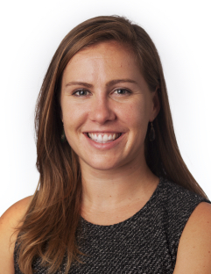
Webinar presenters
Caroline Whistler
CEO & Co-Founder
Third Sector
Dennis Culhane
PI and Co-Founder
Actionable Intelligence for
Social Policy
Laila Goldberg
Director
Third Sector
Whitney LeBoeuf
Research Consultant
Actionable Intelligence for
Social Policy

Slide 4
Agenda
Introduction to the SIF Youth Development Competition
Review applicant eligibility and services to be provided
Review RFP details and selection factors
Next steps and Q&A

Slide 5
Outcomes-oriented contracting combined with integrated data systems will enable govts to develop informative performance feedback loops
TA partners provide a unique combination of expertise
Third Sector Capital Partners, Inc. (Third Sector)
Leads governments, high-performing nonprofits, and private funders in building evidence-based initiatives that address society’s most persistent challenges.
Third Sector’s projects have resulted in over $100M in public dollars shifted to outcomes-oriented programs which use contracting and finance incentives to align resources with results for communities.
Actionable Intelligence for Social Policy (AISP)
Initiative at University of Pennsylvania that focuses on the development and use of integrated data systems (IDS) for policy analysis and program reform, establishing guidelines and standards for IDS development.
Promotes the development of IDS among additional states and counties through its “developing sites” seminars and TA activities, including this initiative.

Slide 6
This opportunity is funded with generous support from the federal Social Innovation Fund
Background on the Social Innovation Fund
The Social Innovation Fund (SIF)
Program of the Corporation for National and Community Service (CNCS)
SIF combines public and private resources to grow the impact of innovative, community-based solutions that have compelling evidence of improving the lives of people in low-income communities throughout the United States

Slide 7
This is a unique opportunity for governments seeking to utilize IDS and outcomes-oriented contracting to improve two-generation outcomes
Key applicant characteristics
1
Improve Youth Development Outcomes
Interested in testing and scaling strategies to improve two-generation outcomes (i.e. outcomes that foster the well-being of both parents and their children)
2
Demonstrate government and leadership commitment to data integration efforts and using data for decision-making
Support Data Integration
3
Pursue Outcomes-
Oriented Contracting
Interested in or currently pursuing outcomes-oriented contracting strategies focused on two-generation outcomes and committed to leveraging IDS for these efforts

Slide 8
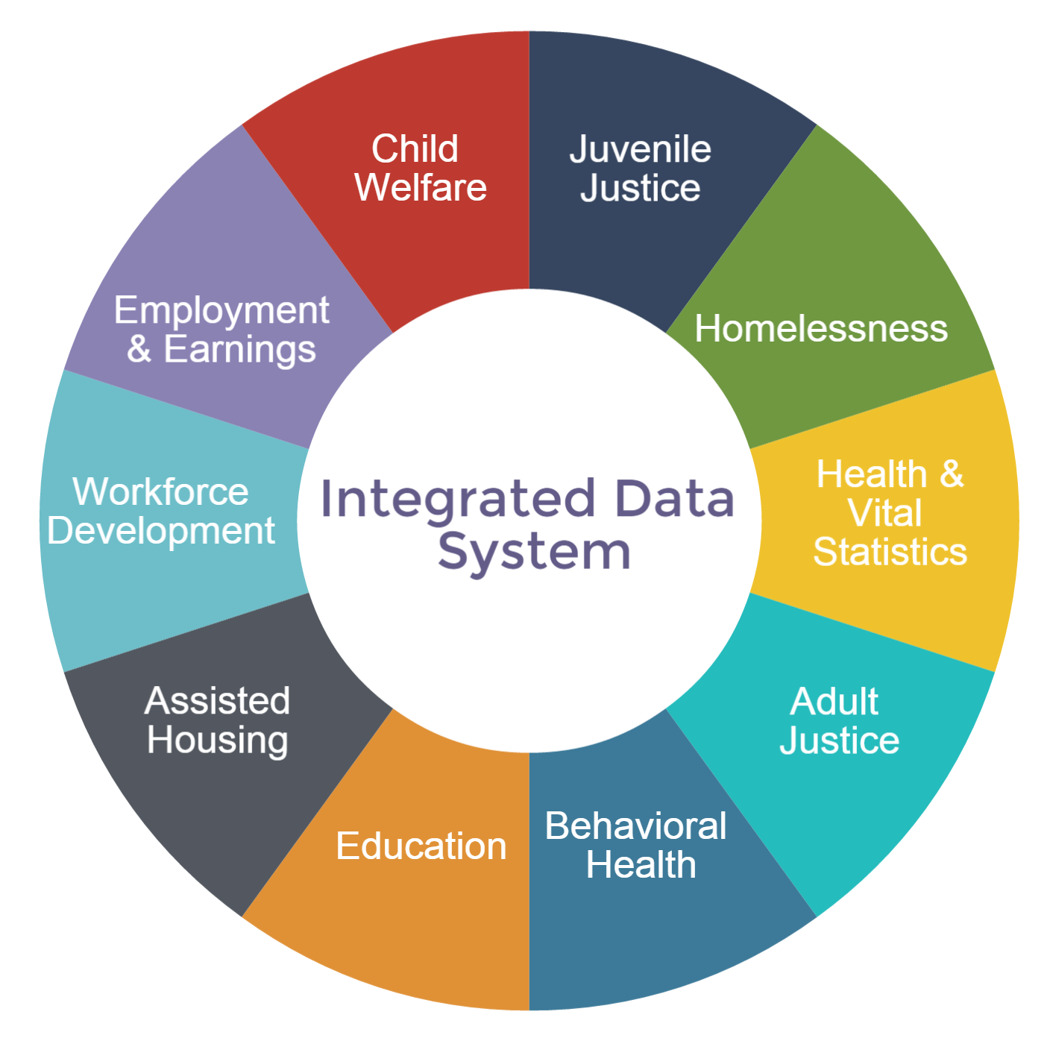
Integrated Data Systems (IDS) foster social innovation by accelerating the knowledge-to-practice development cycle
Characteristics and purpose of IDS
IDS link administrative data across multiple agencies to monitor and track how services are being used and to what effect
Provide agency decision makers with actionable intelligence to better address the needs of beneficiaries
Enable communities to test social policy innovations, implement low-cost evaluations, and pursue continuous quality improvement efforts

Slide 9
Outcomes-oriented contracts give government a performance feedback loop by using data to understand results and inform resource allocation
Using data to improve community impact
Pay for Success (PFS) is one form of outcomes-oriented contracting that raises the bar on traditional government contracts by driving resources toward better, more effective programs:
Rigorous evaluation links performance to outcomes
Providers have more flexibility in intervention implementation
Payments are tied to performance on selected outcomes
Social Innovation Financing is an optional tool used by Pay for Success projects to bridge the timing gap between government payments and the upfront capital needs to implement an intervention (social impact bond)

Slide 10
Two-generation strategies focus on creating opportunities for and addressing needs of both vulnerable children and their parents together
The Two-Generation Continuum ¹
Child
focused
Child
focused with parent elements
e.g., parenting skills or family literacy
Parent focused with child elements
e.g., child care, work supports, and food and nutrition
Parent
focused
Whole family
Five Key Components of the Two-Generation Approach:
Economic Supports (employment, income, childcare, housing, etc.) Early Childhood Education Postsecondary Education and Workforce (early learning, academic success, high-school graduation, stable employment, etc.) Social capital (family engagement, community networks, etc.) Health and well-being (justice, child welfare, preventive care utilization, reduced ER visits, etc.)
(1) http://ascend.aspeninstitute.org/pages/the-two-generation-approach

Slide 11
Community-based examples demonstrate the potential of IDS and outcomes-oriented contracting in practice
Example from the field: Cuyahoga County, Ohio
Problem
Data Insights from IDS
Solution: Partnering for Family Success Program
Homeless families in the County regularly engage with both the Office of Homeless Services and the Division of Children and Family Services
Outreach systems did not interact with each other and limited data was available to understand the issue
Cuyahoga County leveraged data between the two agencies using an IDS to better understand the experience and needs of homeless women and their children
The County worked with Third Sector to launch an outcomes-oriented contract
At its projected level of success, the program could reduce the time children spend in foster care by 25% and save the state over $4M

Slide 12
Agenda
Introduction to the SIF Youth Development Competition
Review applicant eligibility and services to be provided
Review RFP details and selection factors
Next steps and Q&A

Slide 13
Applicants must meet key eligibility criteria to be considered for selection
Applicant eligibility criteria
1
Government
Entity
The lead Applicant must represent a state-level public entity
OR if the primary Applicant is a local jurisdiction (county or city) they must demonstrate a sustained partnership commitment from an involved state-level public entity
State-level Applicants may partner with a specific county or city if the two-generation program of interest is locally administered and committed to IDS development
2
Youth Development &
2-Gen Focus
Area of impact must fall within youth development* and specifically target two-generation outcomes
3
Complete Application
Applicant must answer all questions or requests in the application process
* The definition of youth development for this grant opportunity broadly encompasses programs that serve youth in low-income communities that are traditionally underserved or underrepresented and/or projects supporting and consistent with the mission of the White House Data-Driven Justice Initiative. Youth development programs seek to prepare children and youth for success in school, active citizenship, self-sufficiency, productive work, and healthy and safe lives, including crime reduction initiatives focused on juvenile delinquency and victimization prevention and response.

Slide 14
Sites will receive customized technical assistance designed to accelerate IDS development and outcomes-oriented contracting
TA and services to be provided
Deliver three in-person 2.5-day training modules with pre/post work and individualized consultation between sessions
AISP
Identify two-generation outcomes of interest for the development of outcomes-oriented contracts
PFS feasibility assessment and contracting blueprint
Select sites will move to PFS transaction structuring
AISP
Third Sector
Learning Community
Sites will benefit from a national Learning Community that will draw from the networks of SIF, Third Sector, and AISP to exchange lessons and best practices

Slide 15
AISP will deliver three in-person 2.5-day training modules with pre/post work and individualized consultation between sessions
TA and services to be provided
AISP
Third Sector
Support development of a fully-operable, sustainable IDS:
Establish governance and legal frameworks
Identify priority demonstration projects and data
Plan initial technology platforms
Identify initial funding and staffing for the demonstration phase
Help navigate IDS development challenges specific to the context and stage of each IDS site

Slide 16
Third Sector will work with sites to identify two-generation outcomes of interest for the development of outcomes-oriented contracts
TA and services to be provided
Third Sector
Third Sector will work with sites to explore readiness for outcomes-oriented contracting by addressing questions such as:
What outcomes should be prioritized? How is data on outcomes collected?
Who would a project serve? How is this population currently being served?
How could an evaluation of this population’s outcomes work?
Is there an intervention that can positively impact this population?
Do providers have the capacity to manage to priority outcomes?
What is the expected benefit of the intervention and appropriate “pricing” for prioritized outcomes?
Select sites that demonstrate sufficient readiness will move to transaction structuring (negotiation, drafting, execution of outcomes-oriented contract)

Slide 17
Services will begin in October 2017 and continue through December of 2019; customized workplans will be determined for each site
Timeline and key activities
Oct – Dec 2017
Jan – Dec 2018
Jan – Dec 2019
Kickoff &
Work Planning
IDS Training &
PFS Feasibility
IDS Training &
PFS Transaction Structuring
2017
2018
2019
Onboard key staff to lead IDS development and PFS feasibility efforts
Kickoff engagement and develop a customized TA work plan for each recipient
Formal IDS training and TA focused on IDS Governance and Research & Outcomes Measurement
Provide communities with PFS feasibility assessment focused on two-gen outcomes and offer actionable next steps
Continued IDS training and TA focused on Data Linkage and Data Standards
Assess appropriate technology solutions for data linkage, security and access
Begin structuring and negotiation of outcomes-oriented contracts

Slide 18
Agenda
Introduction to the SIF Youth Development Competition
Review applicant eligibility and services to be provided
Review RFP details and selection factors
Next steps and Q&A

Slide 19
Applications will be evaluated based on a readiness assessment framework that focuses on four key criteria
Selection factors overview
Readiness Assessment Framework
Factor 1 | Demonstrated government and leadership commitment to IDS development and using data for decision-making | 35 Points
Factor 2 | Staff capacity and commitment to utilize and leverage TA resources | 30 points
Factor 3 | Technical capacity of government agencies to build and utilize IDS | 20 Points
Factor 4 | Identification of populations and outcomes of interest with two-generation focus | 15 Points
Total |  | 100 Points
*Applicants are encouraged to include documentation of support through Letters of Support

Slide 20
Sites need leadership commitment to both IDS development and using data for decision-making plus the staff capacity to implement the work
Detail for factors 1 and 2
Leadership Commitment
Factor 1 [ 35 points]
Key stakeholder support
Staff Capacity
Factor 2 [30 points]
Dedicated staff who collaborate across agencies/departments and have decision-making authority
Commitment to both data integration and outcomes-oriented contracting strategies
Community level partnerships with service providers and funders
Four key staff identified to participate in IDS training workshops
Point of contact

Slide 21
Site must demonstrate the technical capacity of agencies to build and utilize IDS and a commitment to improving two-generation outcomes
Detail for factors 3 and 4
Technical Capability
Factor 3 [ 20 points]
Basic data/IT infrastructure in place
Two-generation Outcomes*
Factor 4 [15 points]
Definition of beneficiary population characteristics including geographic service area
Data capacity to access, share, manage and interpret data sources
Experience defining and managing data ownership, security, and privacy policies
Describe current measurement and evaluation capacity
Evidence of the effectiveness of the proposed two-generation intervention
* See table in RFP for examples of two-generation outcomes and data sources

Slide 22
Agenda
Introduction to the SIF Youth Development Competition
Review applicant eligibility and services to be provided
Review RFP details and selection factors
Next steps and Q&A

Slide 23
Applications are due on Friday, July 28
Key dates and next steps
Application process and steps
June 20, 2017 | Application released
June 20 – July 21, 2017 | Open information period, 1-1 calls
Friday, July 28, 2017 | Applications due by 5:00pm PST
July 31 – August 11, 2017 | Full application review
August 14 – August 25, 2017 | Finalist due diligence interviews with selected sites
Week of September 11, 2017 | Announcement of service recipients

Slide 24
FAQs
Next steps
How do I submit questions to the project team?
Potential applicants may submit additional questions to the project team at: SIFcompetition@thirdsectorcap.org
A FAQ document will also be created, updated, and available on the competition webpage
How can I access webinar materials?
This webinar will be posted to the competition page on Third Sector’s website: www.thirdsectorcap.org/youth-development-competition/
When and how can I schedule a 1-on-1 phone call with the project team?
Potential applicants are welcome to schedule a 1-on-1 phone call with the project team to discuss the RFP. These calls can be scheduled by sending an email to: SIFcompetition@thirdsectorcap.org

Slide 25
Webinar presenters
Contact information
Caroline Whistler
cwhistler@thirdsectorcap.org
Dennis Culhane
culhane@upenn.edu
Laila Goldberg
lgoldberg@thirdsectorcap.org
Whitney A LeBoeuf
wleboeuf@upenn.edu

Slide 26
Disclosure
This presentation contains confidential, proprietary, copyright and/or trade secret information of Third Sector Capital Partners that may not be reproduced, disclosed to anyone, or used for the benefit of anyone other than Third Sector Capital Partners unless expressly authorized in writing by an executive officer of Third Sector Capital Partners.
Third Sector Capital Partners, Inc. Boston • San Francisco • Washington, D.C. info@thirdsectorcap.org | www.thirdsectorcap.org

